Slide 1
Introduction to Artificial Intelligence
Uninformed Search
By
Seyed Abolghasem Mirroshandel mirroshandel@gmail.com

Slide 2
Outline
Problem solving by search: definitions
Graph representation
Graph properties and search issues
Uninformed search methods
  depth-first seach
  breath-first
  depth-limited search
  iterative deepening search
  bi-directional search.
Introduction to AI, Guilan University, Fall 2013, Mirroshandel@gmail.com

Slide 3
Problem solving by search
Represent the problem as STATES and OPERATORS that
transform one state into another state. A solution to the
problem is an OPERATOR SEQUENCE that transforms
the INITIAL STATE into a GOAL STATE. Finding the
sequence requires SEARCHING the STATE SPACE by
GENERATING the paths connecting the two.
Introduction to AI, Guilan University, Fall 2013, Mirroshandel@gmail.com

Slide 4
Search by generating states
Initial state
2
3
1
. . .
100
5
4
6
Goal state
Operations
1 --> 2
1 -->6
2 --> 3
2 --> 5
3 --> 5
5 --> 4
Introduction to AI, Guilan University, Fall 2013, Mirroshandel@gmail.com

Slide 5
Basic concepts (1)
State: finite representation of the world at a given time
Operator: a function that transforms a state into another (also called rule, transition, successor function, production, action).
Initial state: world state at the beginning.
Goal state: desired world state (can be several)
Goal test: test to determine if the goal has been reached.
Introduction to AI, Guilan University, Fall 2013, Mirroshandel@gmail.com

Slide 6
Basic concepts (cont.)
Reachable goal: a state for which there exists a sequence of operators to reach it.
State space: set of all reachable states from initial state (possibly infinite)
Cost function: a function that assigns a cost to each operation
Performance:
  cost of the final operator sequence
  cost of finding the sequence
Introduction to AI, Guilan University, Fall 2013, Mirroshandel@gmail.com

Slide 7
Problem formulation
The first task is to formulate the problem in terms of states and operators
Some problems can be naturally defined this way, others not!
Formulation makes a big difference!
Examples:
  water jug problem, tic-tac-toe, 8-puzzle, 8-queen problem, cryptoarithmetic
  robot world, travelling salesman, part assembly
Introduction to AI, Guilan University, Fall 2013, Mirroshandel@gmail.com

Slide 8

Example 1: water jug (1)
Given 4 and 3 liter jugs, a water pump, and a sink,
how do you get exactly two liters into the 4 liter jug?
3
4
State: (x,y) for liters in jugs 1 and 2, integers 0 to 4
Operations: empty jug, fill jug, pour water between jugs
Initial state: (0,0); Goal state: (2,n)
Introduction to AI, Guilan University, Fall 2013, Mirroshandel@gmail.com

Slide 9
Water jug operations
1. (x, y | x < 4) (4, y) Fill 4
2. (x, y | y < 3) (x, 3) Fill 3
3. (x, y | x > 0) (0, y) Dump 4
4. (x, y | y > 0) (x, 0) Dump 3
5. (x, y | x+y >=4 and y>0) (4, y - (4 - x))
Pour from 3 to 4 until 4 is full
6. (x, y | x+y >=3 and x>0) (x - (3 - y), 3)
Pour from 4 to 3 until 3 is full
7. (x, y | x+y <=4 and y>0) (x+y, 0)
Pour all water from 3 to 4
α move
β move
Introduction to AI, Guilan University, Fall 2013, Mirroshandel@gmail.com

Slide 10
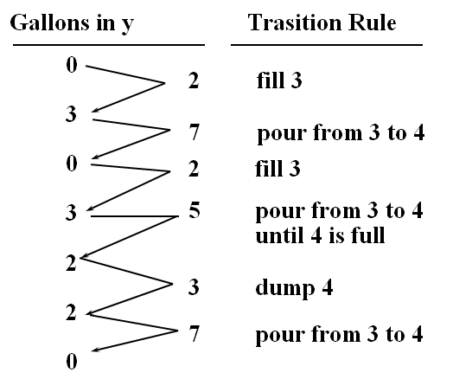
Water Jug Problem: one solution
Introduction to AI, Guilan University, Fall 2013, Mirroshandel@gmail.com

Slide 11
Example 2: cryptoarithmetic
Assign numbers to letters so that the sum is correct
F O R T Y
+ T E N
+ T E N
S I X T Y
2 9 7 8 6
+ 8 5 0
+ 8 5 0
3 1 4 8 6
Solution
F=2, O=9
R=7, T=8
Y=6, E=5
N=0, I=1
X=4
State: a matrix, with letters and numbers
Operations: replace all occurrences of a letter with a digit not already there
Goal test: only digits, sum is correct
Introduction to AI, Guilan University, Fall 2013, Mirroshandel@gmail.com

Slide 12
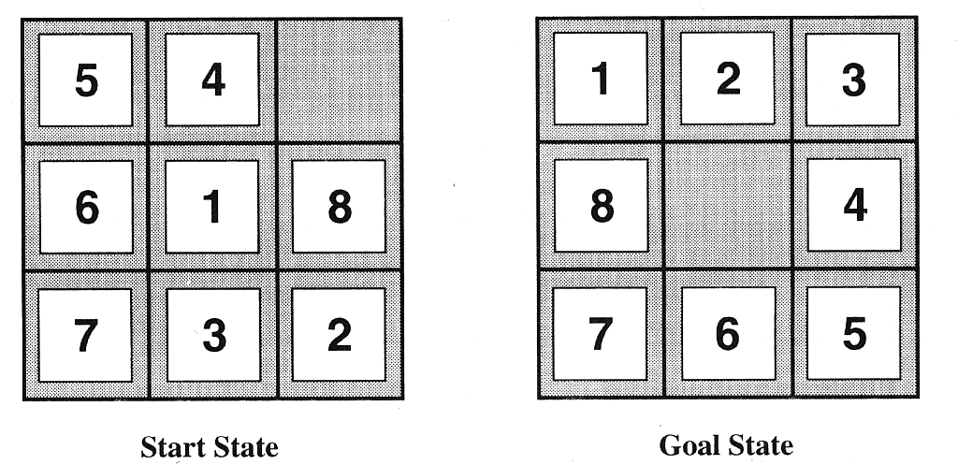
Example 3: 8-puzzle
State: a matrix, with letters and numbers
Operation: exchange tile with adjacent empty space
Goal test: state matches final state; cost is # of moves
Introduction to AI, Guilan University, Fall 2013, Mirroshandel@gmail.com

Slide 13
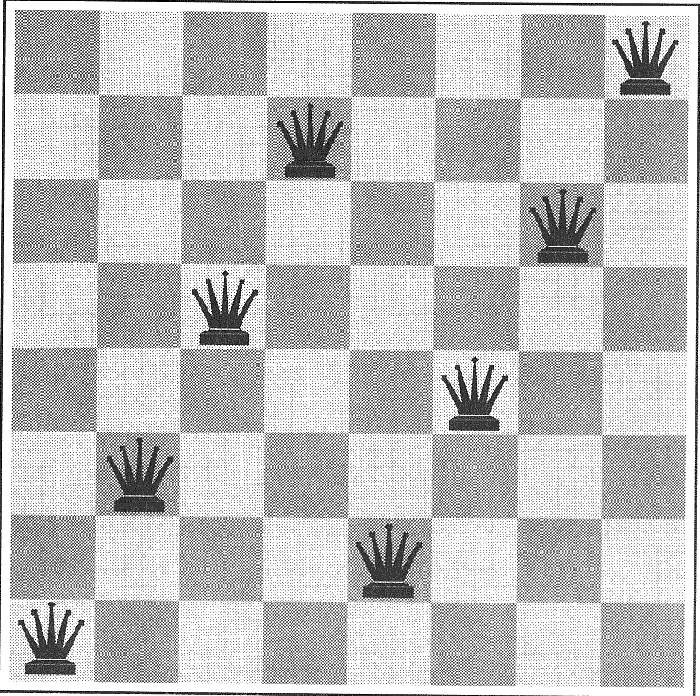
Example 4: 8-queens
State: any arrangement of up to 8 queens on the board
Operation: add a queen (incremental), move a queen (fix-it)
Goal test: no queen is attacked
Improvements: only non-attacked states, place in leftmost non-attacked position (2057 possibilities instead of 64⁸)
Introduction to AI, Guilan University, Fall 2013, Mirroshandel@gmail.com

Slide 14
Graph representation
Nodes represent states G(V,E)
  Directed edges represent operation applications -- labels indicate operation applied
Initial, goal states are start and end nodes
Edge weight: cost of applying an operator
Search: find a path from start to end node
Graph is generated dynamically as we search
Introduction to AI, Guilan University, Fall 2013, Mirroshandel@gmail.com

Slide 15
Graph characteristics
A tree, directed acyclic graph, or graph with cycles -- depends on state repetitions
Number of states (n)
  size of problem space, possibly infinite
Branching factor (b)
  # of operations that can be applied at each state
  maximum number of outgoing edges
Depth level (d)
  number of edges from the initial state
Introduction to AI, Guilan University, Fall 2013, Mirroshandel@gmail.com

Slide 16
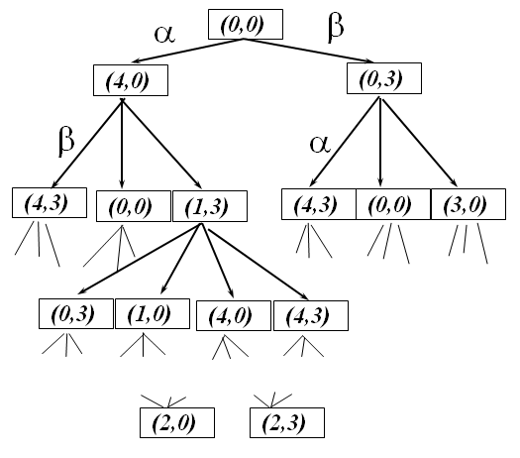
Water jug problem: tree
Introduction to AI, Guilan University, Fall 2013, Mirroshandel@gmail.com

Slide 17
Water jug problem: graph
(0,0)
(4,0)
(0,3)
(1,3)
(4,3)
(3,0)
Introduction to AI, Guilan University, Fall 2013, Mirroshandel@gmail.com

Slide 18
Data structures
State: structure with world parameters
Node:
  state, depth level
  # of predecesors, list of ingoing edges
  # of successors, list of outgoing edges
Edge: from and to state, operation number, cost
Operation: from state, to state, matching function
Hash table of operations
Queue to keep states to be expanded
Introduction to AI, Guilan University, Fall 2013, Mirroshandel@gmail.com

Slide 19
General search algorithm
function General-Search(problem) returns solution
nodes := Make-Queue(Make-Node(Initial-State(problem))
loop do
if nodes is empty then return failure
node := Remove-Front (nodes)
if Goal-Test[problem] applied to State(node) succeeds
then return node
new-nodes := Expand (node, Operators[problem]))
nodes := Insert-In-Queue(new-nodes)
end
Introduction to AI, Guilan University, Fall 2013, Mirroshandel@gmail.com

Slide 20
Search issues: graph generation
Tree vs. graph
  how to handle state repetitions?
  what to do with infinite branches?
How to select the next state to expand
  uninformed vs. informed heuristic search
Direction of expansion
  from start to goal, from goal to start, both.
Efficiency
  What is the most efficient way to search?
Introduction to AI, Guilan University, Fall 2013, Mirroshandel@gmail.com

Slide 21
Properties of search strategies
Completeness
  guarantees to find a solution if a solution exists, or return fail if none exists
Time complexity
  # of operations applied in the search
Space complexity
  # of nodes stored during the search
Optimality
  Does the strategy find the highest-quality?
Introduction to AI, Guilan University, Fall 2013, Mirroshandel@gmail.com

Slide 22
Factors that affect search efficiency
1. More start or goal states? Move towards the larger set
G
I
G
G
I
I
G
I
Introduction to AI, Guilan University, Fall 2013, Mirroshandel@gmail.com

Slide 23
Factors that affect search efficiency
2. Branching factor: move in the direction with the lower branching factor
G
I
G
I
Introduction to AI, Guilan University, Fall 2013, Mirroshandel@gmail.com

Slide 24
Uninformed search methods
No a-priori knowledge on which node is best to expand (ex: crypto-arithmetic problem)
Methods
  Depth-first search (DFS)
  Breath-first search (BFS)
  Depth-limited search
  Iterative deepening search
  Bidirectional search
Introduction to AI, Guilan University, Fall 2013, Mirroshandel@gmail.com

Slide 25
A graph search problem...
4
4
A
B
C
3
S
G
5
5
G
4
3
D
E
F
2
4
Introduction to AI, Guilan University, Fall 2013, Mirroshandel@gmail.com

Slide 26
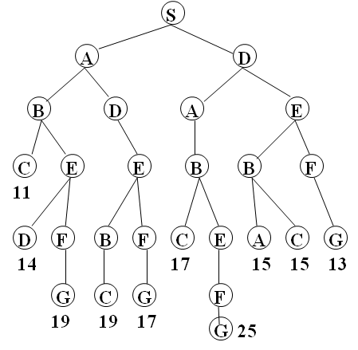
… becomes a tree
Introduction to AI, Guilan University, Fall 2013, Mirroshandel@gmail.com

Slide 27
Depth first search
Dive into the search tree as far as you can, backing up only when there is no way to proceed
function Depth-First-Search(problem) returns solution
nodes := Make-Queue(Make-Node(Initial-State(problem))
loop do
if nodes is empty then return failure
node := Remove-Front (nodes)
if Goal-Test[problem] applied to State(node) succeeds
then return node
new-nodes := Expand (node, Operarors[problem]))
nodes := Insert-At-Front-of-Queue(new-nodes)
end
Introduction to AI, Guilan University, Fall 2013, Mirroshandel@gmail.com

Slide 28
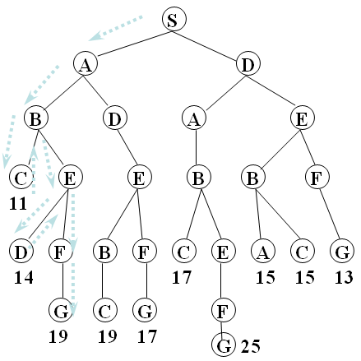
Depth-first search
Introduction to AI, Guilan University, Fall 2013, Mirroshandel@gmail.com

Slide 29
Breath-first search
Expand the tree in successive layers, uniformly looking at all nodes at level n before progressing to level n+1
function Breath-First-Search(problem) returns solution
nodes := Make-Queue(Make-Node(Initial-State(problem))
loop do
if nodes is empty then return failure
node := Remove-Front (nodes)
if Goal-Test[problem] applied to State(node) succeeds
then return node
new-nodes := Expand (node, Operators[problem]))
nodes := Insert-At-End-of-Queue(new-nodes)
end
Introduction to AI, Guilan University, Fall 2013, Mirroshandel@gmail.com

Slide 30
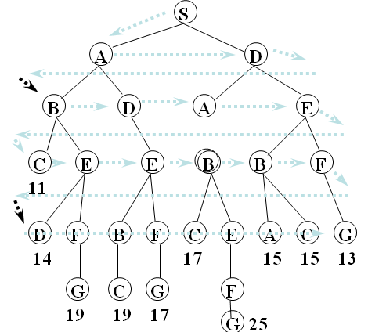
Breath-first search
Introduction to AI, Guilan University, Fall 2013, Mirroshandel@gmail.com

Slide 31
Depth-limited search
Like DFS, but the search is limited to a predefined depth.
The depth of each state is recorded as it is generated. When picking the next state to expand, only those with depth less or equal than the current depth are expanded.
Once all the nodes of a given depth are explored, the current depth is incremented.
Combination of DFS and BFS. Change the Insert-Queue function in the algorithm above.
Introduction to AI, Guilan University, Fall 2013, Mirroshandel@gmail.com

Slide 32
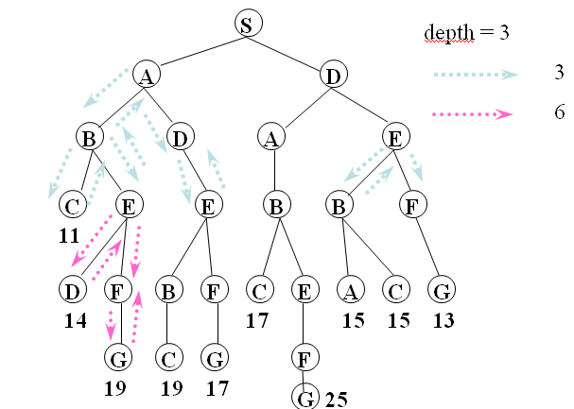
Depth-limited search
Introduction to AI, Guilan University, Fall 2013, Mirroshandel@gmail.com

Slide 33
IDS: Iterative deepening search
Problem: what is a good depth limit?
Answer: make it adaptive!
Generate solutions at depth 1, 2, ….
function Iterative-Deepening-Search(problem) returns solution
nodes := Make-Queue(Make-Node(Initial-State(problem)
for depth := 0 to infinity
if Depth-Limited-Search(problem, depth) succeeds
then return its result
end
return failure
Introduction to AI, Guilan University, Fall 2013, Mirroshandel@gmail.com

Slide 34
Iterative deepening search
S
S
S
A
D
Limit = 0
Limit = 1
S
S
S
A
D
A
D
B
D
A
E
Limit = 2
Introduction to AI, Guilan University, Fall 2013, Mirroshandel@gmail.com

Slide 35
Iterative search is not as wasteful as it might seem
The root subtree is computed every time instead of storing it!
Most of the solutions are in the bottom leaves anyhow: b + b² + …+ b^{d} = O(b^{d})
Repeating the search takes:
(d+1)1 + (d)b + (d - 1)b² + … (1)b^{d} = O(b^{d})
For b = 10 and d = 5 the number of nodes searched is 111,111 regular vs. 123,456 repeated (only 11% more) !!
Introduction to AI, Guilan University, Fall 2013, Mirroshandel@gmail.com

Slide 36
Bidirectional search
Expand nodes from the start and goal state simultaneously. Check at each stage if the nodes of one have been generated by the other. If so, the path concatenation is the solution
The operators must be reversible
single start, single goal
Efficient check for identical states
Type of search that happens in each half
Introduction to AI, Guilan University, Fall 2013, Mirroshandel@gmail.com

Slide 37
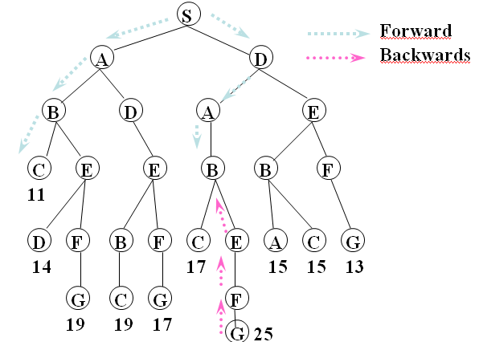
Bidirectional search
Introduction to AI, Guilan University, Fall 2013, Mirroshandel@gmail.com

Slide 38
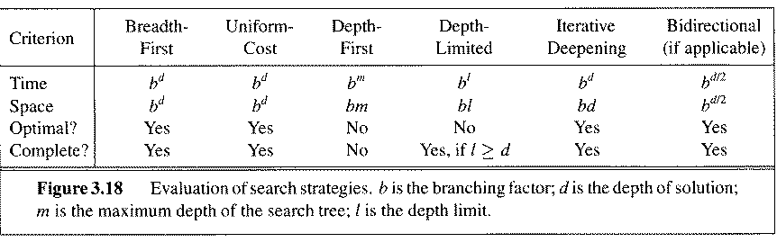
Comparing search strategies
Introduction to AI, Guilan University, Fall 2013, Mirroshandel@gmail.com

Slide 39
Repeated states
Repeated states can the source of great inefficiency: identical subtrees will be explored many times!
A
A
B
B
B
C
C
C
C
C
How much effort to invest in detecting repetitions?
Introduction to AI, Guilan University, Fall 2013, Mirroshandel@gmail.com

Slide 40
Strategies for repeated states
Do not expand the state that was just generated
  constant time, prevents cycles of length one, ie., A,B,A,B….
Do not expand states that appear in the path
  depth of node, prevents some cycles of the type A,B,C,D,A
Do not expand states that were expanded before
  can be expensive! Use hash table to avoid looking at all nodes every time.
Introduction to AI, Guilan University, Fall 2013, Mirroshandel@gmail.com

Slide 41
Summary: uninformed search
Problem formulation and representation is key!
Implementation as expanding directed graph of states and transitions
Appropriate for problems where no solution is known and many combinations must be tried
Problem space is of exponential size in the number of world states -- NP-hard problems
Fails due to lack of space and/or time.
Introduction to AI, Guilan University, Fall 2013, Mirroshandel@gmail.com

